Slide 1
INTERNSHIP STUDIO INTERNSHIP FOR ETHICAL HACKING TASK – 3 Name – Sovan Das

Slide 2
STEPS INVOLVED
Use burpsuit for this method
Open Firefox and set the proxy setting as burpsuit proxy
Turn on intercept in burpsuit
In Firefox open the link http://testasp.vulnweb.com
Forward in intercept in burpsuit
Try the XSS script <script>alert(1)</script > in search box
In burpsuit forward the response in intruder
In intruder section, post the XSS scripts and start attack
Check which XSS script that intruded, copy the response of it and paste it in Firefox browser to see how it works
Here <script>alert(1)</script> works and gives out an response of script injection

Slide 3
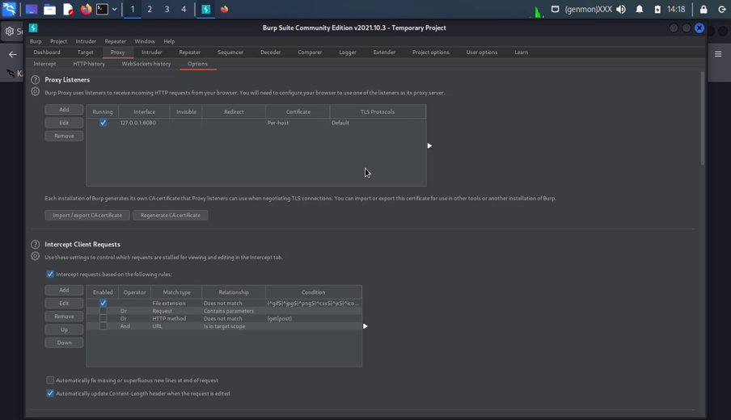
Screenshots

Slide 4
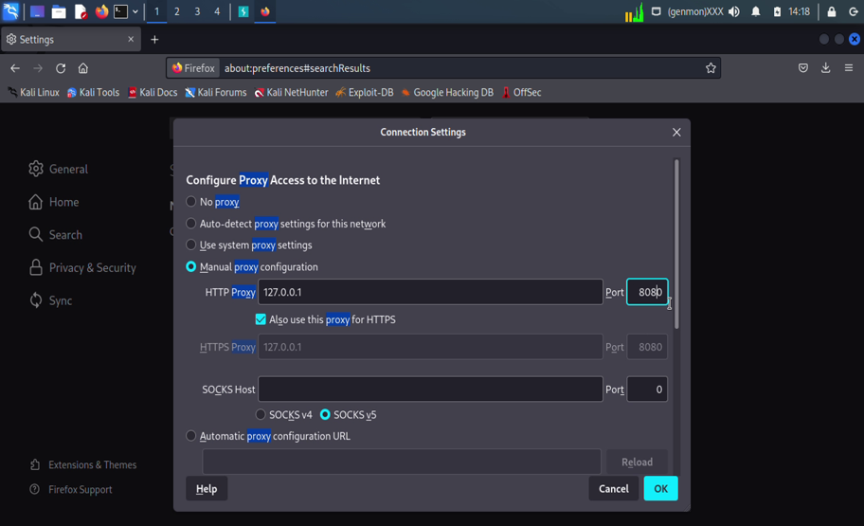
Screenshots

Slide 5
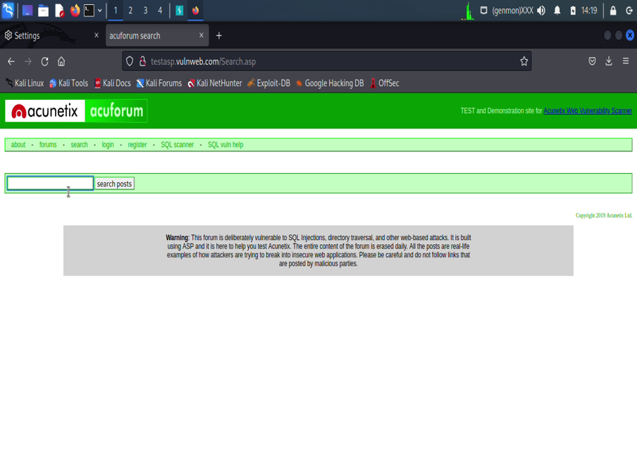
Screenshots

Slide 6
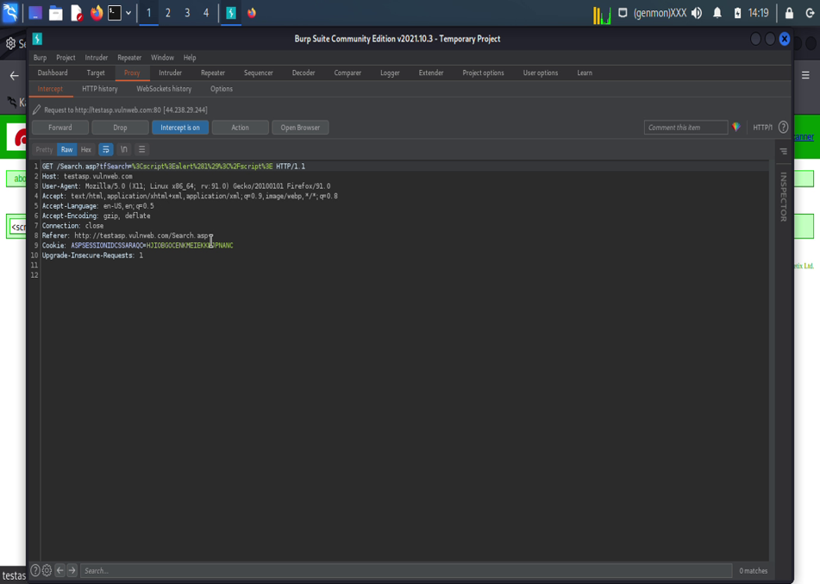
Screenshots

Slide 7
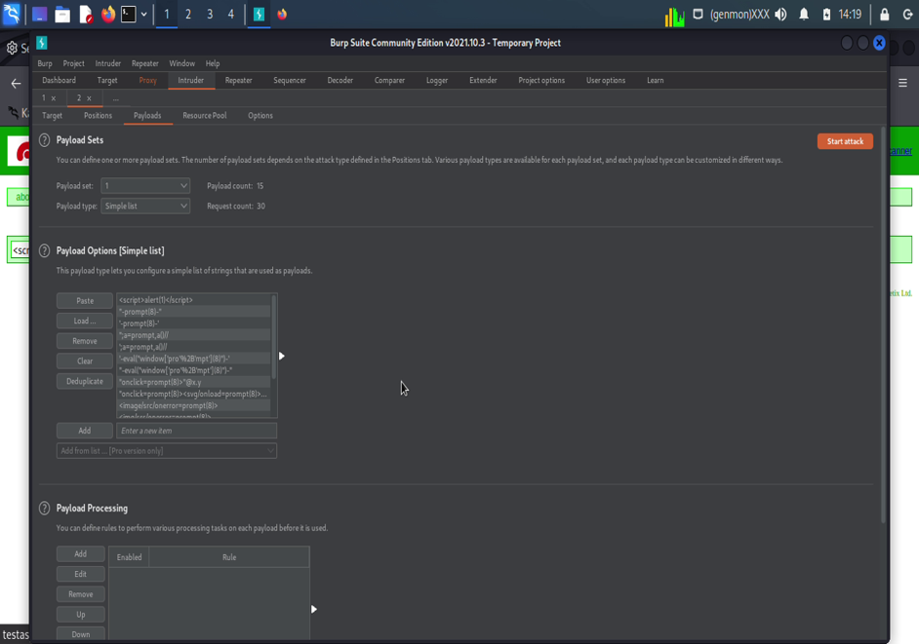
Screenshots

Slide 8
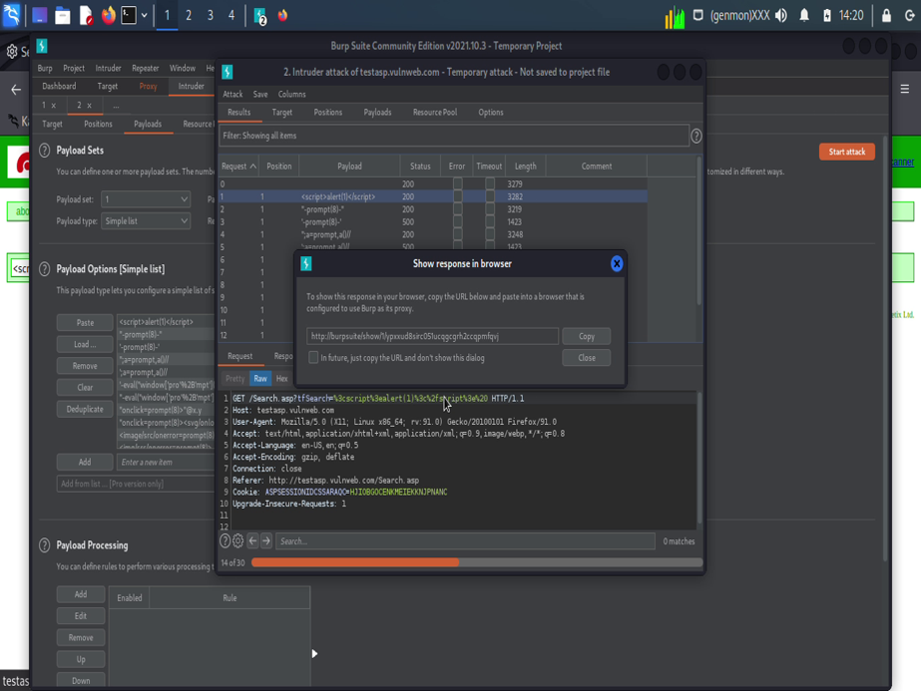
Screenshots

Slide 9
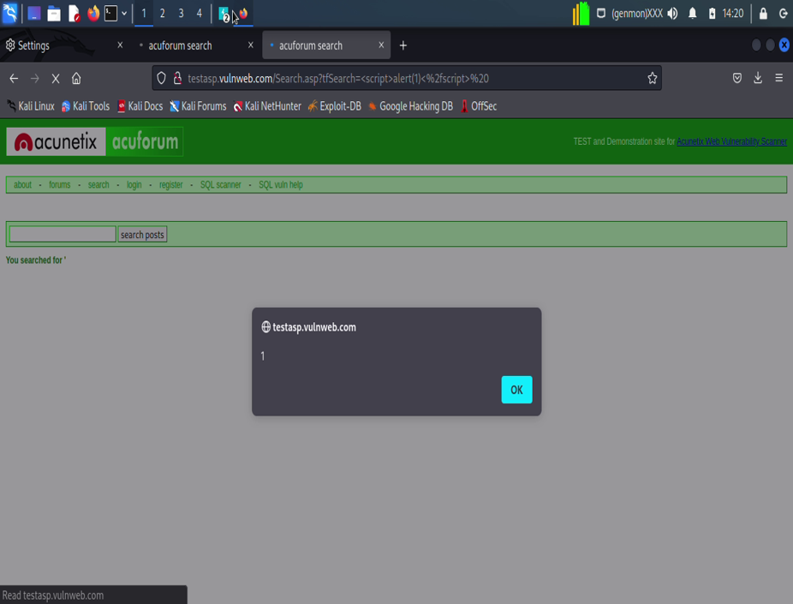
Screenshots

Slide 10
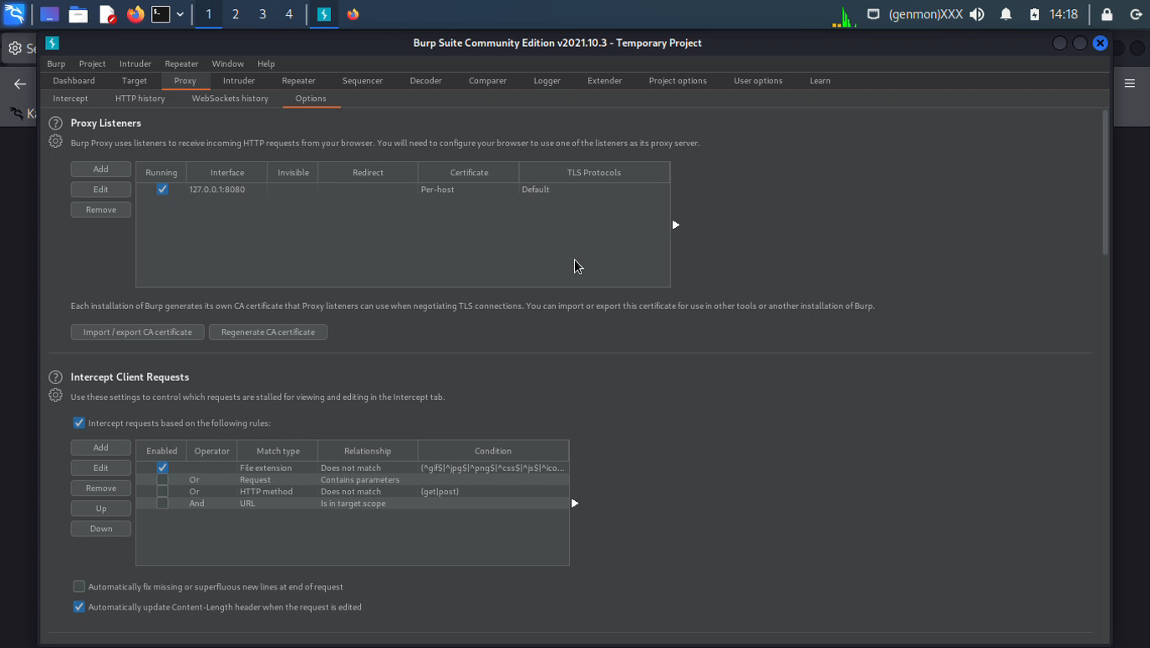
Screen Recording

